Slide 1
Docker-compose
Velocity training institute
Shantanu Mahajan (sr engg devops)

Slide 2
What is docker compose?
Docker Compose is a tool that was developed to help define and share multi-container applications.
Docker compose is a tool for defining and running multi-container docker applications
With compose, you can use a compose file to configure your application services. Then you use a single command, you create and start all the services from your configuration.
Compose have multiple commands so as to start, stop, rebuild, view the status of running services.

Slide 3
Docker compose file
Docker compose uses a yaml file where you define all the steps.
Default file Is docker-compose.yml or docker-compose.yaml

Slide 4
YAML -
YAML stands for YAML Ain’t Markup Language.
Previously, it stood for Yet Another Markup Language.
YAML is a very simple, text-based, human-readable language used to exchange data between people and computers.
YAML is not a programming language. It is mostly used for storing configuration information.
YAML files store data, and they do not include commands and instructions.
YAML is a data serialization language similar to XML or JSON.

Slide 5
Basic syntax of yaml
YAML is used to store key-value pairs, or mappings, and lists, or sequences of elements.
<key>: <value>
where <key> represents name and <value> represents data separated by : (the space is mandatory).
In yaml file whatever data we will give is line by line.

Slide 6
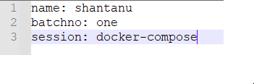
syntax
key: value
Eg:-

Slide 7
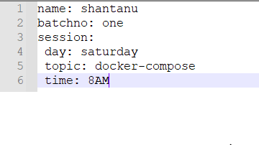
syntax
In yaml any key can also have a child key.
Here, more important is indentation, only spaces allowed no tabs.

Slide 8
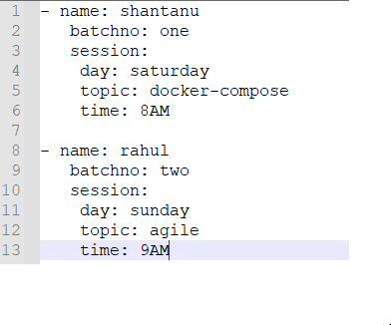
syntax
Sometime we may also need to group parent keys, where we will having something called as sections.
Sections are represented by hyphen.

Slide 9
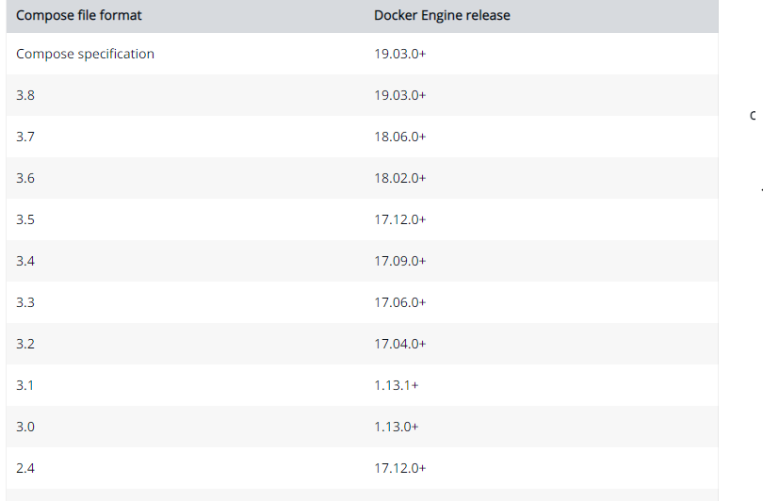
Docker compose file
Version:- There are several versions of the Compose file format – 1, 2, 2.x, and 3.x.

Slide 10
Docker compose file
Service:- A service definition contains configuration that is applied to each container started for that service, much like passing command-line parameters to docker run.
In simple words collection of everything that i want to tell docker-compose to create a container or multiple containers i.e what is the image you want how many containers etc.
Here in compose we are not going to refer as a container but as a service.
Docker compose will not create container it will create service, service will include image, containers, ports etc.
Compose handles everything as a service

Slide 11
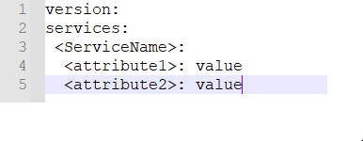
Docker compose file

Slide 12
Install docker compose
https://docs.docker.com/compose/install/

Slide 13
commands
To run compose-file:- docker-compose –f <compose-file> options servicename
To create/start container:- docker-compose up
To start in detach mode:- docker-compose up –d
To start specific service:- docker-compose up –f <servicename>
To list container:- docker-compose ps <service>
To stop-remove container:- docker-compose down

Slide 14
commands
List images:- docker-compose images
Build services:- docker-compose build servicename
View output of container:- docker-compose logs –f service
Stop services :- docker-compose stop sevicename
Remove:- docker-compose rm servicename
Execute commands in a running container:- docker-compose exec service command
Execute commands in a running container detach mode:- docker-compose exec –d …
Scaling container:- docker-compose up –d --scale service=num

